Slide 2
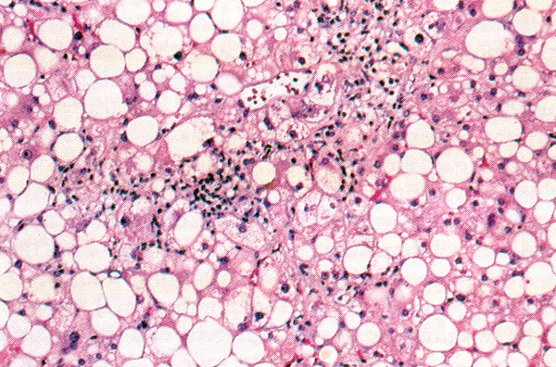
HISTOLOGY OF ACUTE FATTY LIVER OF PREGNANCY

Slide 3
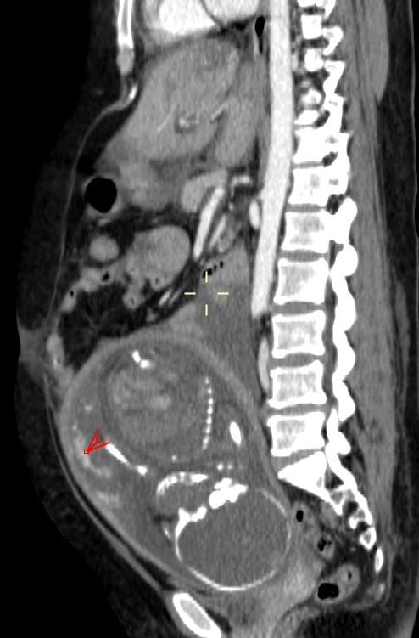

Slide 4
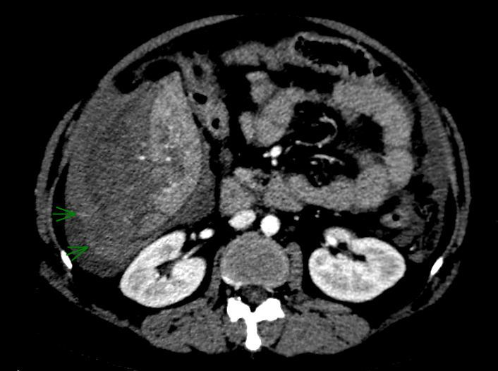

Slide 5
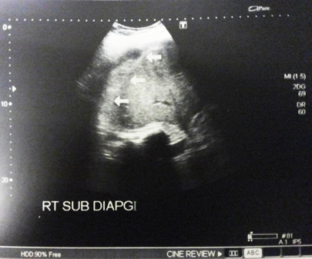
HELLP - NON EXPANDING HEMATOMA IN LIVER

Slide 6
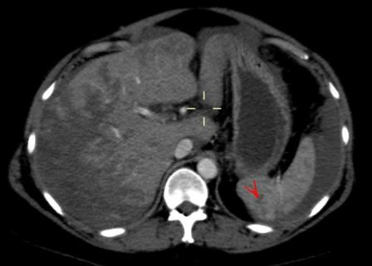

Slide 7
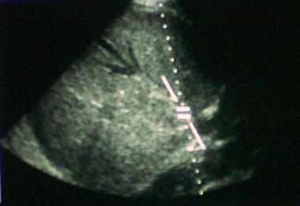

Slide 9
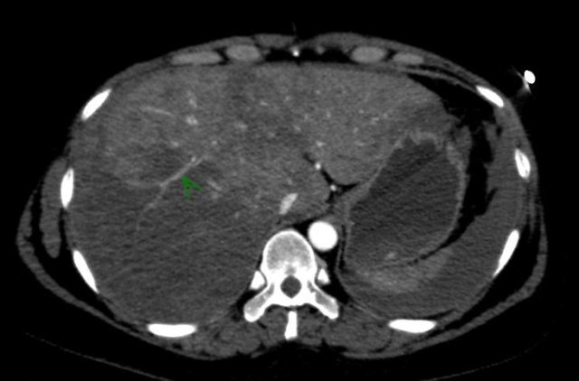

Slide 10
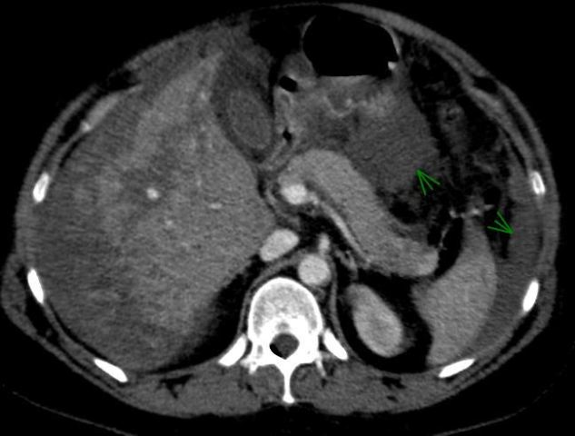

Slide 11
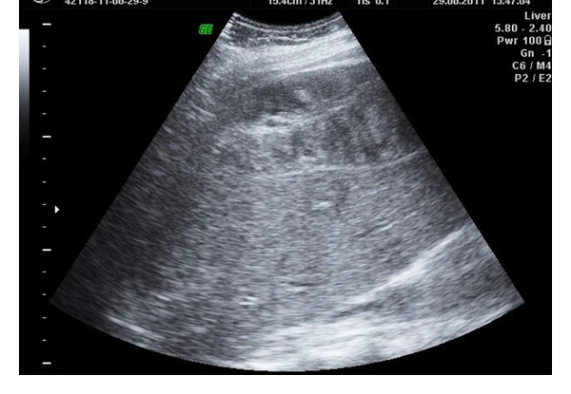
LARGE SUB CAPSULAR HEMATOMA

Slide 12
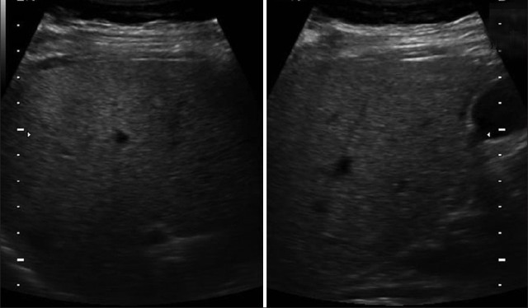
ACUTE FATTY LIVER IN PREGNANCY

