Slide 1
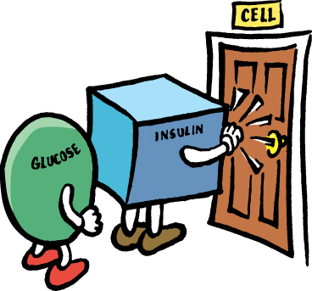
What this program is about …
Preventing or delaying diabetes
Prediabetes
Notes:
Explain key concepts of Insulin Resistance Syndrome
Insulin Resistance Syndrome describes a condition where an individual is unable to use insulin properly (insulin resistance) to move glucose into cells where it is used for energy
In response, the body produces and releases more insulin (hyperinsulinemia)
Insulin resistance is a combination of many risk factors associated with cardiovascular disease (heart attacks, strokes) and type 2 diabetes
Not everyone with insulin resistance syndrome goes on to develop diabetes
However, everyone with the syndrome is at high risk for cardiovascular disease

Slide 3
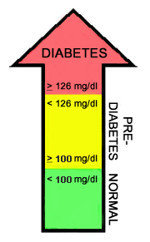
What is Pre-Diabetes?
Comes before type 2 diabetes
Blood glucose higher than normal, but not yet diabetes
Prediabetes is a serious condition with a high risk
of progressing to diabetes and heart disease.
Prediabetes leads to increase glucose in blood.
Confirmatory test for prediabetes is FBS
Diabetes
Fasting blood glucose of 126 mg/dl or higher
Pre-diabetes
Fasting blood glucose of 100 - 125 mg/dl
IDEAL FASTING BLOOD GLUCOSE <100MG/DL

Slide 4
The hormone that lowers blood sugar is insulin
The organ that secretes insulin is pancreas
Technically, prediabetes may result from one of two conditions called Impaired Fasting Glycaemia and Impaired Glucose Tolerance.
However, the effect is the same it means raised blood sugar and a higher risk of getting diabetes and heart disease.
To prevent progression, patients need to make
lifestyle changes in terms of healthier eating
(losing weight) and increased physical activity.

Slide 5
Natural History of IGT
25%
IGT
25%
Normal
50%
T2DM
IGT -after 10 years

Slide 6
RISK FACTORS
NON-MODIFIABLE RISK FACTORS
Genetic disorders-parents or sibling
Age >45 years
Racial and ethnic factors- African-Americans, Hispanics, American Indians, Asian-Americans and Pacific Islanders
Gestational diabetes
Poly cystic ovary disease.

Slide 7
MODIFIABLE RISK FACTORS
Over weight- The more fatty tissue especially inside and between the muscle and skin around your abdomen — the more resistant your cells become to insulin
Increase waist size-normal male<90cm,female<80cm
Excess fat
Inactive
Lack of sleep
Increase stress
Unhealthy food habits

Slide 8
Other conditions associated with diabetes include:
High blood pressure
Low levels of HDL, or the "good," cholesterol
High levels of triglycerides — a type of fat in your blood
When these conditions — high blood pressure, high blood sugar, and abnormal blood fats and cholesterol — occur together along with obesity, they are associated with resistance to insulin. The combination of three or more of these conditions is often referred to as metabolic syndrome.

Slide 9
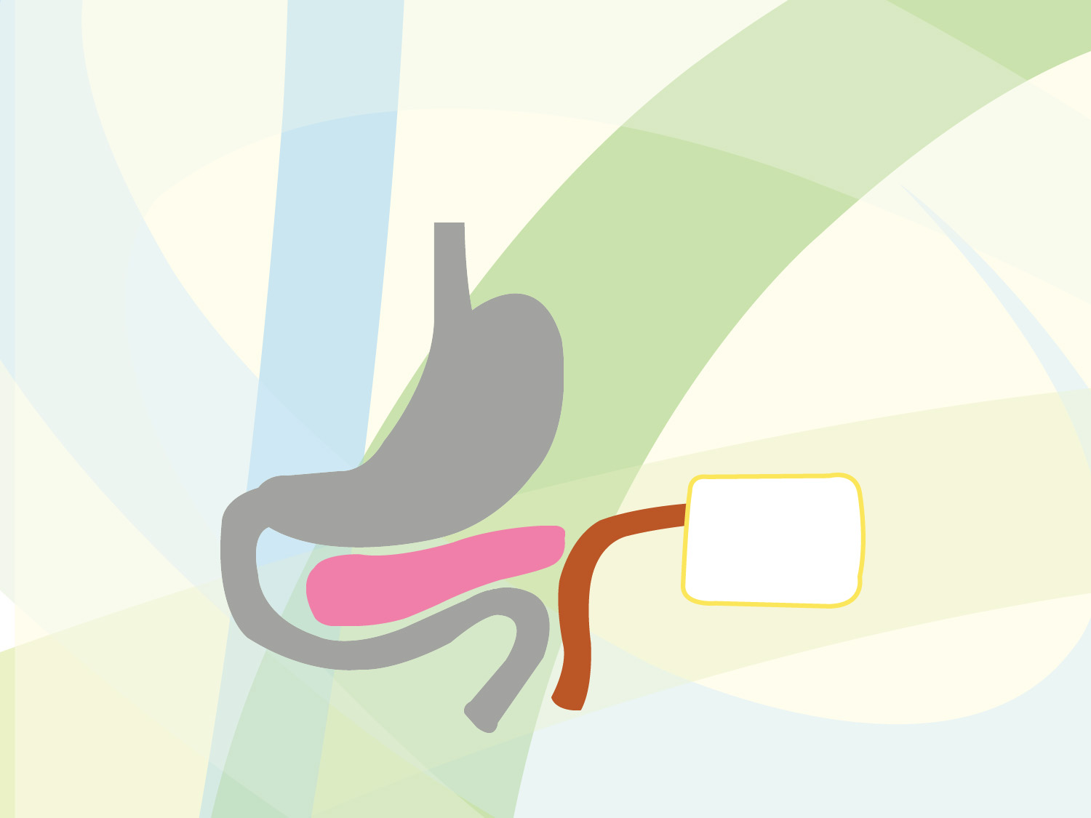
How food is digested …
1. Food enters stomach
4. Pancreas releases insulin
5. Insulin unlocks receptors
6. Glucose enters cell
3. Glucose enters bloodstream
2. Food is converted into glucose
Notes:
Explain key concepts of Insulin Resistance Syndrome
Insulin Resistance Syndrome describes a condition where an individual is unable to use insulin properly (insulin resistance) to move glucose into cells where it is used for energy
In response, the body produces and releases more insulin (hyperinsulinemia)
Insulin resistance is a combination of many risk factors associated with cardiovascular disease (heart attacks, strokes) and type 2 diabetes
Not everyone with insulin resistance syndrome goes on to develop diabetes
However, everyone with the syndrome is at high risk for cardiovascular disease

Slide 11
There are three main things that contribute to becoming prediabetic, and the progression to diabetes:
1. What you eat: Being overweight affects the body’s ability to process sugar in the blood.
2. What you do: Long periods of inactivity (e.g. watching television all evening) reduce the ability of insulin to deal with sugar in the blood. But being physically active increases the efficiency of the insulin.
3. The genes you inherit also contribute to the development of prediabetes.

Slide 12
DIAGNOSTIC MEASURES
Fasting blood glucose-8 hrs after fasting overnight.
Normal-<100mg/dl, pre –diabetes-100-125mg/dl
OGTT-fasting blood sugar, followed by a sugary drink and 2 hrs later blood sample taken.
Normal-<140mg/dl, pre –diabetes-140-199mg/dl
HBA1C-done at any time during day. No need of fasting. Result reflect of an average blood sugar of 3 months.
Normal-<5.6%, pre –diabetes-5.7%-6.4%

Slide 13
Signs and symptoms
prediabetes has no signs or symptoms
One possible sign that you may be at risk of type 2 diabetes is darkened skin on certain parts( neck, arm pits, inside elbows, behind the knees and on knuckles) of the body. This condition is called Acanthosis Nigricans.
Sleeping less than 6 hrs on a regular basis
Pre diabetes tends to be subtle.
Prediabetes leads to heart disesaes

Slide 14
LIFE STYLE MEASURES
AIM BMI-18.5-25
EAT A BALANCED DIET
MOVE MORE
EERCISE 30 MTS /DAY FOR 5 DAYS
LOAD VEGETABLES, FRUITS AND LESS STARCH FOODS.
CHOOSE AND COMMIT
GET SUPPORT WHEN NEEDED
SLEEP WELL- Create a sleep schedule
Avoid caffeine,alcohol,smoking
Relax before turning off light
Don’t work or read newspaper
Turn off mobile,TV,Computer

Slide 15
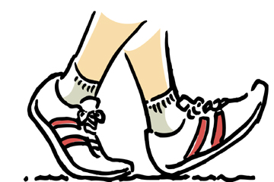
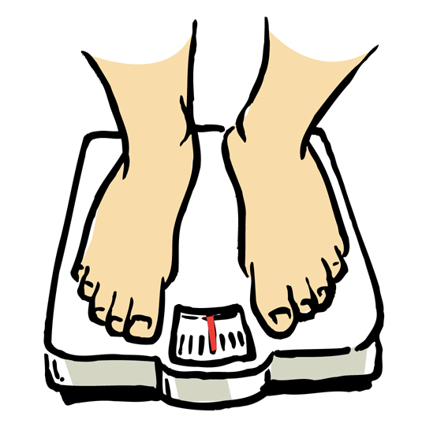
The good news …
You can prevent or delay type 2 diabetes through:
More nutritious eating
Regular physical activity
(150 minutes a week)
Moderate weight loss
(7% of body weight)
Notes:
Review Bullet Points
The Diabetes Prevention Program is a recent study that showed how better eating, regular exercise and modest weight loss can prevent or delay the development of type 2 diabetes in people at risk.
Other studies have shown that these three strategies significantly reduce the risk for cardiovascular complications

Slide 16
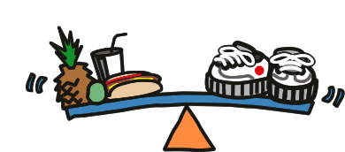
Balance is the cornerstone of prevention
More Nutritious Eating
Regular Physical Activity
Moderate Weight Loss
Notes:
Introduce the concept of striking a balance between nutritious eating and regular exercise to achieve moderate weight loss

Slide 17
What is nutritious eating?
Limit saturated fats (butter, cheese, fatty meats)
Cut back on total amount of fat you eat (less oils, salad dressing, fried foods)
Try to eat more fiber each day
Eat fruits and/or vegetables at each meal
Try to eat smaller meals at regular times
Include low glycemic index foods
Balance your total calories with your energy needs
Notes:
Review Bullet Points
Explain Role of Nutritious Eating
Eating less fat with more fiber reduces the amount of unhealthy fats in the blood
Nutritious eating allows you to lose weight without creating new health problems

Slide 18
GLYCEMIC INDEX FOODS
GLYCEMIC INDE X–it’s the measurement carried out on CHO foods and their impact on blood sugar. Its expressed in numbers.
The foods that release glucose rapidly into blood stream are called high glycemic index foods.
The lower the glycemic index the lower is the demand for insulin.
GI VALUE 55-LESS
56-79=MODERATE
>75=HIGH

Slide 19
GLYCEMIC INDEX FOODS
LOW GI FOODS
Oats
Barley
Brown rice, nuts
Cucumber, carrot,
onion ,tomatoes,
Sweet potato
green leafy vegetables
Yogurt, milk,
whole grains
Apple,grapes,mango,
Orange, apricots
HIGH GI FOODS
White rice
Baked potatoes and raw potatoes
Honey
White bread
Pumpkin
Water melon

Slide 20
FOODS THAT INCREASE GLUCOSE-wheat ,jowar, rice, skimmed milk, refined oils and cereals.
FOODS THAT PREVENT INCRESAE IN GLUCOSE-Eggs, lean meat, sprouts, green leafy vegetables, fish, coconut oil.
HELATHIER CHOICES
NUTS AND SEEDS-High in fiber
FRUITS AND VEGETABLES-High fiber and vitamins
WHOLE GRAINS
MILLETS-Vitamins and minerals. Increase magnesium content improves ability of cells to respond to insulin and glucose receptors within blood.
LESS RED MEAT-Has more saturated fat content.

Slide 21
EASY STEPS FOR HEALTHIER EATING
Eat breakfast
Choose variety
Eat nuts
Be selective about meat
Drink moderately
Eliminate trans fats
Enjoy morning coffee
Drink 8-12 glasses of water
Try plate method
Limit fats
Manage stress
Sleep not less than 6 hrs
Avoid smoking

Slide 22
Key ways to reduce your risk!
1. Activity! Aim for 30 minutes of activity at least 5 days per week (this should be something that makes you breathe faster or your heart beat faster). Try 20 minutes on 3 days per week in the 1 st month.
2. Lose weight! Aim for 5% weight loss over several
months. Try to lose 5 pounds or 2.5kg in 2-3 months at first.
3. Eat healthy food! Replace fat (especially saturated fat) with healthier options. Build up to 5 portions of fruit and vegetables each day over some months.
4. Try to stop smoking! Start by seeking professional advice and make a clear plan before setting a firm date to stop.
5. Even making small changes can help to lower risks.

Slide 23
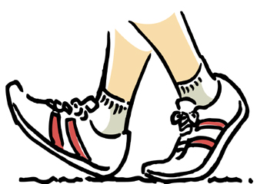
What is regular physical activity?
Brisk walking, bicycling, swimming or jogging
Start with 5-10 minutes a day, 3-5 days a week
Shoot for a total of 150 minutes a week
Mild activities
Washing,laundry,walking,
stretching, gardening,dusting.
Notes:
Review Bullet Points
Emphasize that there are many ways to exercise
It is important to pick an activity that is enjoyable, otherwise it will be hard to stick with it
Brisk walking is one of the easiest exercises to get started with – it requires not special equipment, and can be done indoors (shopping malls) and outdoors
Explain role/benefits of exercise
Improves circulation and respiratory system
Lowers blood pressure
Increases sensitivity to insulin action
Promotes gradual weight loss
Helps maintain desired weight
Improves energy level (you feel better)
Improves your sleeping
Emphasize the need for people to talk with their physicians to see if there are any health problems that would limit their ability to exercise

Slide 24
What are the benefits of exercise?
Lowers blood glucose and blood pressure and controls cholesterol
Strengthens heart, lung and circulatory systems
Control appetite
Improves bone density
Burns out excess body fat and Promotes weight loss
Strengthens bones, increases muscle tone and stamina
Improves quality of sleep
Notes:
Review Bullet Points
Emphasize that only moderate weight loss (5-10% of total body weight) is needed to see real benefits

Slide 25
More benefits of exercise...
Decreases stress, increases enthusiasm and optimism.
Reduces depression
Improves blood flow to the brain
Tone muscles
Increase insulin sensitivity
Improves the way you feel about yourself!
Notes:
Review Bullet Points
Emphasize that only moderate weight loss (5-10% of total body weight) is needed to see real benefits

Slide 26
DEMONSTRATION OF WALKING
Warm up is a must(shrug shoulders, Tap toes, look over your shoulder).
Drink plenty of water
Choose a safe place to walk
Walk with chin up, back straight, toes pointed forward.
Swing arms as one walks.
Use proper foot wear to make walking comfortable.
Wear clothes that will keep dry and comfortable
First walk slow for 5mts,increase speed net 5 mts.cool down and walk slowly for 15 mts.

Slide 27
Avoid stiff or sore muscles or joints by slowly and gradually increasing the speed.
Walk test-carry on light conversation while one walk.
Go slowly … set realistic goals
Lose 1-2 pounds a week
Lose 7% of total body weight in 6 months
Use waist measurements to track abdominal fat loss
Use total body weight to track overall weight loss

Slide 28
Hyperglycemia Can Cause Serious Long-Term Problems
Notes:
KEY MESSAGE: Over time, high blood glucose can lead to serious medical problems.
In 2004 68% of diabetes-related deaths were among people aged 65 years and older.
Stroke was noted on 16% of diabetes-related death certificates among people aged 65 and older.
Hypertension 2008: Adults aged 20 year or older with self-reported diabetes, 67% had blood pressures greater than or equal to 140/90 or used prescription meds.
Blindness: Diabetes is the leading cause of new cases of blindness among adults aged 20-74 years. 4.2 million (28.5%) of the people with diabetes 40 years or older had diabetic retinopathy, and of these, 4.4% had advanced retinopathy that leads to sever vision loss.
Kidney disease: Diabetes is the leading cause of kidney failure, accounting for 44% of new cases in 2008. 48,374 people with diabetes began treatment for end-stage kidney disease in the US. A total of 202,290 people with end-stage kidney disease were living on dialysis or with a kidney transplant in the US.
Nerve Damage: About 60-70% of the people with diabetes have mild to sever forms of nervous system damage.
Amputation: Diabetes for 10 years or more increases this risk and neuropathy or a previous ulcer is the most significant risk factor of developing lower extremity disease. Callouses can cause up to 30% more pressure on the feet and should be followed up by a professional. More than 60% of non-traumatic lower-limb amputation were performed in people with diabetes.
Cost of Diabetes Care: in 2007 $218 billion dollars in the US: 18 billion for undiagnosed diabetes, 25 billion for adults with prediabetes, and 623 million for gestational diabetes. National Diabetes Fact Sheet, 2011 the most recent comprehensive assessment of the impact of diabetes.
Supporting Points
Over time, hyperglycemia can damage large blood vessels, leading to stroke, heart attack, and loss of circulation in the arms and legs. According to the ADA, heart disease is the leading cause of diabetes-related deaths. People with diabetes are two to four times more likely to die of heart disease than those without diabetes.
Hyperglycemia also can damage small blood vessels and nerves, causing blindness, kidney disease, and other problems. Diabetes is the leading cause of kidney disease (nephropathy) and blindness (retinopathy) in adults under age 75. Diabetes also is a major cause of lower limb amputation. Other complications (not shown) include dental disease, complications of pregnancy, and sexual dysfunction.
Untreated diabetes can cause serious complications even if a person feels fine. Type 2 diabetes has been called a “silent killer” because many people are not aware they have the disease until they develop serious complications.
People with diabetes can reduce the risk of long-term complications by following their recommended diabetes care plans. For both type 1 and type 2 diabetes, major studies have shown that people who maintain their blood glucose as close to normal as possible reduce their risk of serious long-term complications.

Slide 29
Pulling it all together …
Set reasonable goals
Start eating more nutritious meals
Reduce fat
Concentrate on low glycemic index foods
Increase fruits, vegetables and whole grains
Reduce calories for weight reduction
Start exercising
Do brisk walking and cycling
Work up to 150 minutes per week of brisk walking
Monitor your success!
Keep a diary of your eating and exercise
Track your weight loss, fat loss and other factors
Be patient and don’t give up

