Slide 1
CARDIAC CATHETERIZATION
PRESENTED BY
RAJESH.B M.Sc (N) – II YEAR
ARVINTH COLLEGE OF NURSING

Slide 2
INTRODUCTION
Cardiac catheterization provides definitive confirmation of narrowing in the coronary arteries and may also exclude the presence of coronary artery disease before heart valve surgery or other major surgery.
This procedure may also be performed emergently for persons with suspected heart attack to identify blood clots in the coronary arteries and rapidly restore blood flow to the heart muscle.

Slide 3
DEFINITION
Cardiac catheterization is a test during which flexible tubes called catheters are inserted into the heart via an artery or vein under x-ray guidance to diagnose and sometimes treat certain heart conditions.

Slide 4
RIGHT HEART CATHETERIZATION
During right heart catheterization,a vein from the neck, arm, or leg is used to enter the right side of the heart to measure pressures and oxygen content.

Slide 5
LEFT HEART CATHETERIZATION
During left heart catheterization, an artery from the wrist, arm, or leg is used to enter the left side of the heart, usually to perform coronary angiography, which refers to the injection of contrast dye into the coronary arteries to determine the amount of blockage from atherosclerotic plaque.

Slide 6
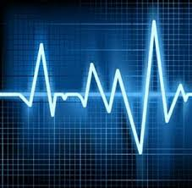
INDICATIONS
Heart Attack
Abnormal Stress Test
New-onset unexplained heart failure
Survival of sudden cardiac death or dangerous cardiac arrhythmia
Persistent chest pain despite optimal medical therapy
Workup of suspected Prinzmetal Angina

Slide 7
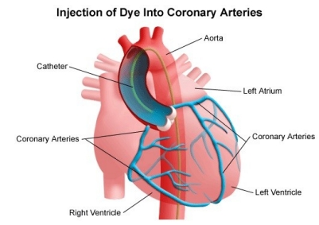
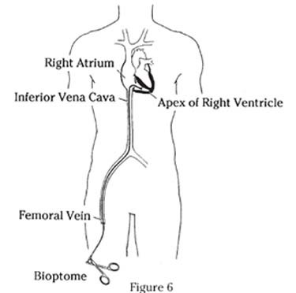
INVESTIGATIVE TECHNIQUES
to measure intracardiac and intravascular blood pressures
to take tissue samples for biopsy
to inject various agents for measuring blood flow in the heart; also to detect and quantify the presence of an intracardiac shunt
to inject contrast agents in order to study the shape of the heart vessels and chambers and how they change as the heart beats

Slide 8
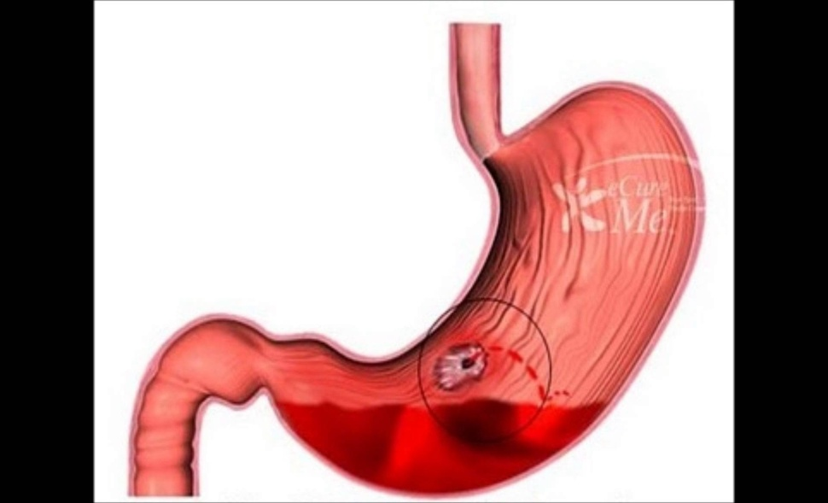
CONTRAINDICATIONS
Severe uncontrolled hypertension
Ventricular arrhythmias
Acute stroke
Severe anemia
Active gastrointestinal bleeding
Allergy to radiographic contrast

Slide 9
CONTRAINDICATIONS
Acute renal failure
Uncompensated congestive failure (so that the patient cannot lie flat)
Unexplained febrile illness or untreated active infection
Electrolyte abnormalities (eg, hypokalemia)
Severe coagulopathy

Slide 10
EQUIPMENT
The basic components include a needle, wire, and sheath.
The most common sheath sizes for radial intervention are 5F-7F.
Some cardiologists prefer the longer sheaths to minimize artery spasms.

Slide 11
EQUIPMENT
Regardless of the artery used, it should ideally be entered during the first needle stick. Repeat attempts induce trauma and spasms.
Lidocaine (1-2%) should be injected superficially around the artery. It may be combined with a tiny amount of nitroglycerin to help promote arterial vasodilatation. Arterial puncture is usually performed with a 21- or 22-gauge needle.

Slide 12
EQUIPMENT
Next, a small-caliber wire (0.018 to 0.025-inch diameter) is advanced through the cannula into the artery, and the cannula is removed so that a sheath with a tapered tip can be inserted over the wire.
Common causes of wire resistance include abnormal anatomy, tortuosity of the vessels, and spasm. If resistance occurs, the wire must be threaded under fluoroscopic guidance.

Slide 13
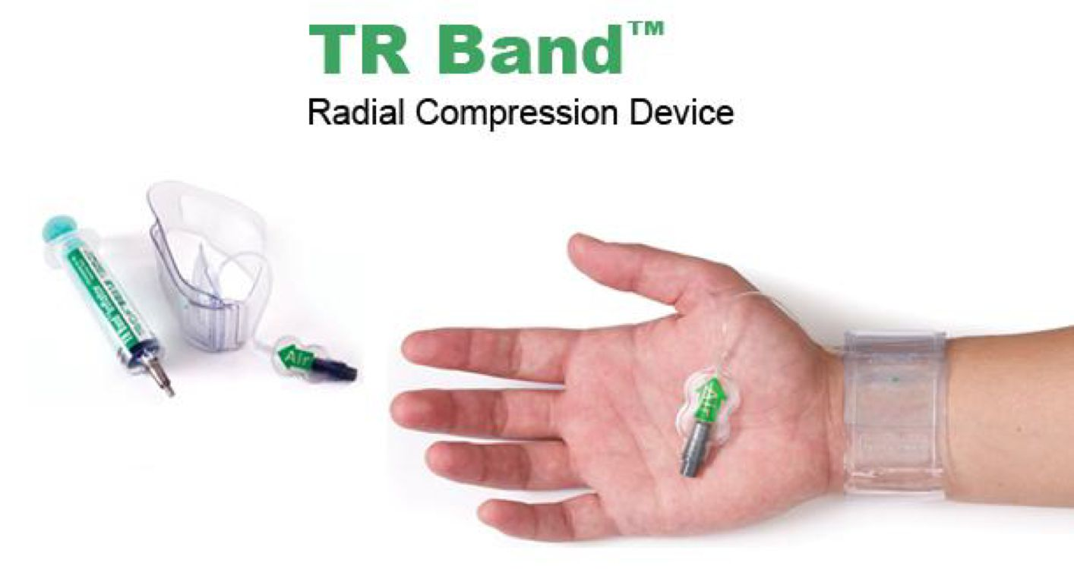
EQUIPMENT
After the procedure in the groin, a heavy pressure dressing is applied. For the wrist, most cardiologists recommend immobilizing the wrist with a splint for the first 24 hours. This helps prevent excessive wrist motion and bleeding.
Like the FemoStop devices used for the groin, a number of wristbands (TR band) can be used to obtain hemostasis in the wrist. These 2- to 3-inch–wide bands are applied after the procedure is over and provide firm compression to the puncture site.

Slide 14
APPROACH CONSIDERATIONS
Femoral artery approach
The percutaneous femoral approach for cardiac catheterization has been widely used and is clearly well established. Unlike the brachial artery approach, the femoral artery approach does not require an arterial cutdown or repair. In addition, the technique can be performed repeatedly in the same patient after a suitable interval.

Slide 15
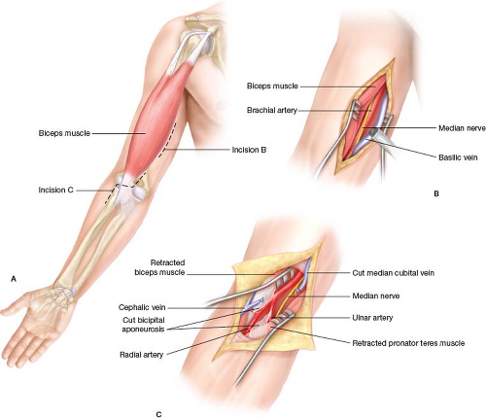
APPROACH CONSIDERATIONS
Radial artery approach
The technique was successful in most patients, but pulse loss was evident in some patients at the end of the procedure.
Brachial artery approach
The brachial approach is rarely used and usually requires a cutdown. The incision is made just above the crease of the elbow, and the brachial artery and vein are isolated. The brachial artery cannot be used more than 2-3 times for cardiac catheterization.

Slide 16
PATIENT PREPARATION
Patients need to fast after midnight, but some laboratories allow the patient to have a light liquid breakfast.
Vital signs are obtained once the patient arrives to the laboratory.
The patient’s entire hand and arm up to the shoulder is prepared and draped in the usual sterile fashion. In addition, one of the groin areas (usually the right groin) should also be prepared and draped in case the radial artery access fails or there is an urgent need for placement of a transvenous pacemaker or an intra-aortic balloon pump.

Slide 17
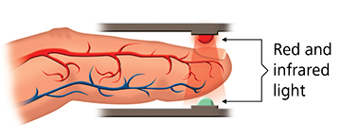
PATIENT PREPARATION
A suitable sized intravenous line should be placed in the contralateral arm, and the blood pressure cuff is usually placed on the leg.
The wrist should be slightly hyperextended with a rolled towel underneath the joint for support. A pulse oximeter is placed on the ipsilateral index finger or thumb.
Clothing (other than hospital gown), jewelry, bracelets, and rings should be removed prior to the procedure. These items must be documented and stored securely.

Slide 18
Premedication of the patient
Medications and doses used during cardiac catheterizations are as follows:
Nitroglycerin 200 µg/mL (administered via the radial and brachial artery)
Verapamil 500 µg/mL (administered via the radial artery)
Lidocaine 2% 20-mg aliquots (administered via the radial artery)
Papaverine wipe on (radial)
Heparin 5,000-10,000 units
Fentanyl 25-50 µg IV prn every 30-45 minutes (transradially, 5 mg IV PRN every 5-15 minutes)
Midazolam 0.5-2 mg/mL IV prn every 15-30 minutes

Slide 19
Positioning:
For both radial and femoral artery catheterization, patients are placed supine. The arms are tucked at the side of the bed for femoral artery access. For radial artery access, the nondominant arm is used and is usually abducted to about 45° to allow for access.

Slide 20
PROCEDURE

Slide 21
PROCEDURE
Cardiologist will numb the area on the arm, groin (upper thigh), or neck where the catheter will enter patient’s blood vessel. Then, a needle will be used to make a small hole in the blood vessel. Doctor will put a tapered tube called a sheath through the hole.
Next, cardiologist will put a thin, flexible guide wire through the sheath and into patient blood vessel. He or she will thread the wire through blood vessel to heart.
Cardiologist will use the guide wire to correctly place the catheter. He or she will put the catheter through the sheath and slide it over the guide wire and into the coronary arteries.
Special x-ray movies will be taken of the guide wire and the catheter as they're moved into the heart. The movies will help the doctor see where to put the tip of the catheter.
When the catheter reaches the right spot, the doctor will use it to do tests or treatments on patient’s heart.

Slide 22
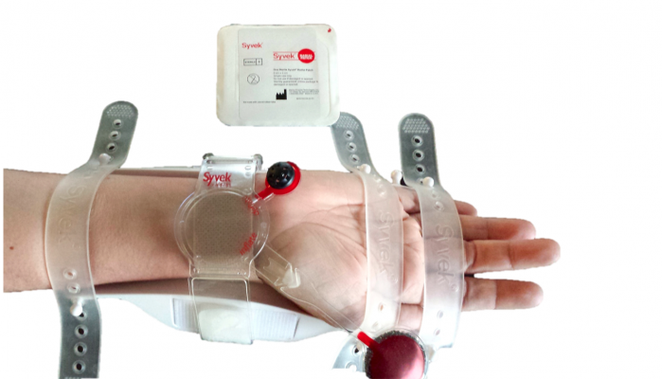
MONITORING & FOLLOW-UP
Once the procedure is complete, most cardiologists remove the intra-arterial lines without confirming anticoagulation parameters. Even in patients in whom GPIIb/IIIa inhibitors and/or thrombolytics have been administered, sheaths can be removed and hemostasis obtained.
This should take 20-30 min with manual compression- more time if mechanical compression devices are used.
Monitor vital signs and assess the site every hour until the patient is stabilized.

Slide 23
MONITORING & FOLLOW-UP
During the assessment, palpate the site and assess temperature, color, pulses and any discomfort present in the extremity used for access.
Elevate the head end of the bed to 30 degrees.
Assess for a bruit, which indicates a condition in which vascular flow is compromised, such as pseudoaneurysm or arteriovenous fistula.

Slide 24
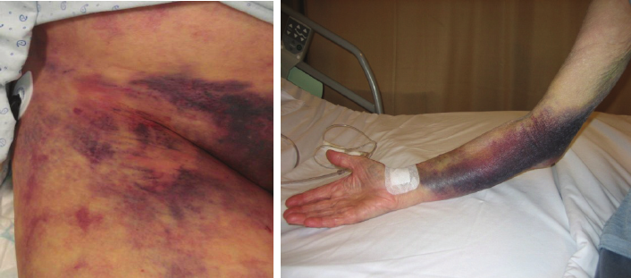
MONITORING & FOLLOW-UP
Document assessment findings, including hematoma size: hematoma characteristics (such as soft or firm): skin color and temperature: and the presence of pedal pulses, bruits, or both.
For both radial and femoral artery access, the hand or feet are assessed for perfusion and capillary refill.
In most cases of radial artery cannulation, the patient can ambulate 1-2 hours after sheath removal or whenever the sedation has worn off.

Slide 25
MONITORING & FOLLOW-UP
Patients who undergo femoral artery access are asked to remain on bed rest for a minimum of 6-8 hours.
After discharge, all patients are asked to avoid excessive use of the involved hand for 24 hours or to refrain from walking until the following morning. Any activity that causes excessive flexion or extension of the wrist/hip is not recommended. The bruising that is common after the procedure usually disappears within 7-10 days.

Slide 26
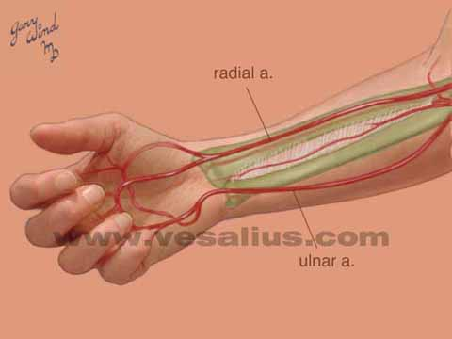
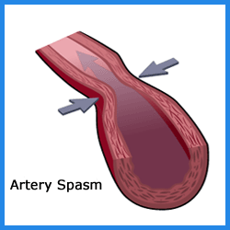
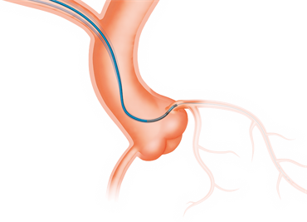
OTHER CONSIDERATIONS
Difficult guidewire entry:
This may be related to the following:
Tortuosity
Vessel spasm
Radial artery stenosis or occlusion
Guidewire may be in a side branch
Abnormal radial artery takeoff from brachial artery
Wire abutting the wall

Slide 27
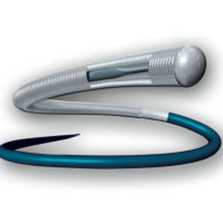
In such scenarios, the following may be attempted:
The use of fluoroscopy for guidance
Rotation of the needle to change bevel angle
Use a smaller diameter hydrophilic wire
Administer a vasodilators intra-arterially through the needle and then attempt to advance the wire

Slide 28
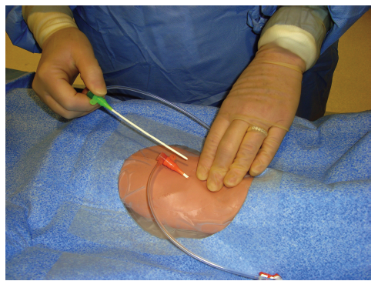
`
Difficulty removing sheath:
This is rare but can occur in small patients, especially women, and often results from intense spasm. If this occurs, the following may be tried:
Administer vasodilators prior to removal
Administer pain medication
Gently rotate the sheath during removal while applying distal skin traction

Slide 29
Hemostasis:
Prior to the availability of hemostatic devices, the cardiologist or nurse had to apply manual pressure to the groin for 30-45 minutes to obtain hemostasis postprocedure. Now, there are several methods of obtaining hemostasis at the catheter insertion site. The choice of method to obtain hemostasis is strictly personal preference of the cardiologist.

Slide 30
Difficulties of transradial intervention:
Unlike the femoral artery, which is large and easily palpated, the radial artery is small, and the pulsations are not strong. The first needle stick is done with care because a miss usually results in vessel spasm. In such cases, there are several options, as follows:
Delay the procedure for 2-30 minutes to allow the spasm to resolve
Attempt cannulation at a proximal site
Administer nitroglycerin (sublingually, intravenously, or topically on the hand)
Ask the patient to open and close hands for a few minutes
Use the brachial artery, contralateral radial artery, or femoral artery

Slide 31
Radiation exposure:
Radiation exposure is unavoidable regardless of the access route selected.
There is evidence that using the radial artery to perform coronary interventions often results in more radiation exposure than the femoral artery approach, and this is greater when using the right arm than the left.
Radiation exposure generally decreases as operator experience increases.

Slide 32
PREVENTION AND MANAGEMENT OF COMPLICATIONS
Major complications:
Mortality: <1%
Risk people are
Vascular heart diseases
CKD
DM requiring insulin therapy
Peripheral arterial disease
Pulmonary insufficiency
Cerebrovascular disease

Slide 33
Major complications:
Myocardial infarction <0.1%
Stroke & Transient Ischemic Attack 0.07-0.1%
Prevented by
- Paying careful attention to flushing and injection technique, minimize dwell time of guidewire in the aortic root of patients who are not fully anticoagulated.
- Carefully wipe and immerse guidewires in heparinized saline before their reintroduction.

Slide 34
Local vascular complications:
Femoral Artery Laceration:
Control by placement of upsized sheath.
If not control then manual pressure around the sheath until procedure is complete.
Then reverse anticoagulation and remove the sheath and prolong compression for 30-60 minnor placement of closure device.
If bleeding continue the urgent vascular surgeon consult to be taken.

Slide 35
Hematoma formation:
Hematoma is a localized swelling filled with blood.
Management:
No need of surgical repair.
Presented by accurate puncture and puncture site compression or closure technique to minimize hematoma formation.

Slide 36
Retroperitoneal hematoma:
When the puncture occur above the inguinal ligament and forms hematoma, is called retroperitoneal hematoma.
Management:
Usually conservative, bed rest and blood transfusion.
Reversal of anticoagulation if bleeding persists or hemodynamic compromise.
Arteriovenous fistula:
Management: Surgical repair.

Slide 37
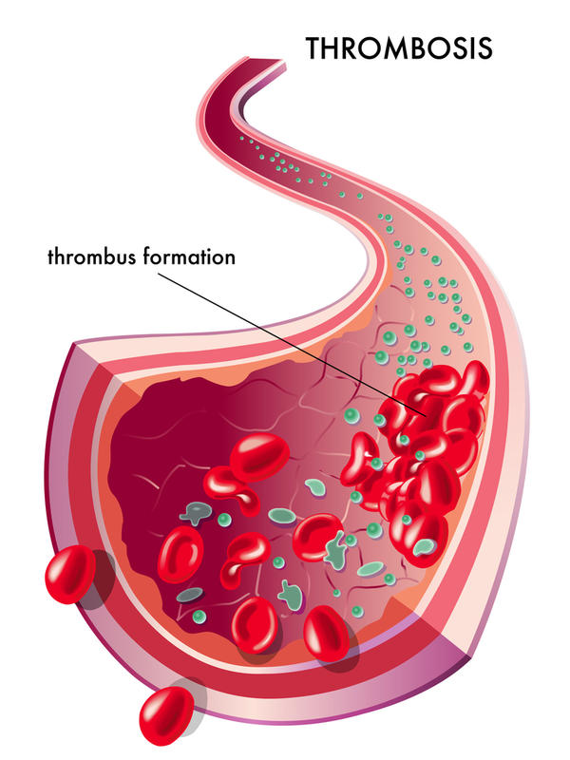
Pseudoaneurysm: 0.1-0.2%
It is caused by damage to the blood vessel. Rarely, the catheter may scrape or poke a hole in a blood vessel as it’s threaded to the heart.
Management:
Surgical repair or ultrasound compression are recommended to reduce the risk of rupture.
Arterial thrombosis:
Management:
Urgent vascular surgery or thrombectomy.

Slide 38
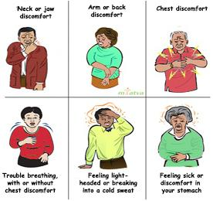
Arrhythmias:
It is an irregular heart beat or rhythm.
Management:
Antiarrythmic drug.
Pace maker.
Electro cardioversion.
Vasovagal reaction:
It includes bradycardia, hypotension, and sweating.
Management:
Fluid volume administration.
Atropine and removal of painful stimulus.

Slide 39
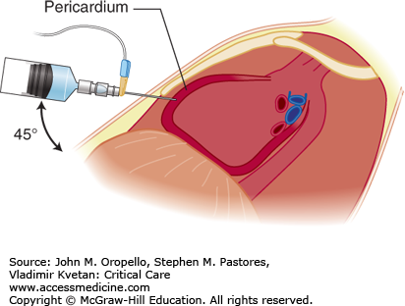
Perforation of heart and great vessels.(leads to pericardial effusion)
It is a collection of fluid in pericardial sac.
Management:
Urgent pericardiocentesis (Removal of fluid from pericardial sac)
Reversal of anticoagulation by protamine.

Slide 40
Allergic reaction:
It is the allergic reaction caused by injection of dye.
Management:
If anaphylactic reaction, then use epinephrine 1:10000, administered IV every minute until pulse restored.
IV fluids infused rapidly as overall fluid status warrants.
Consider vasopressor if hypotension does not responds.
IV hydrocortisone.
If bradycardia consider atropine.

Slide 41
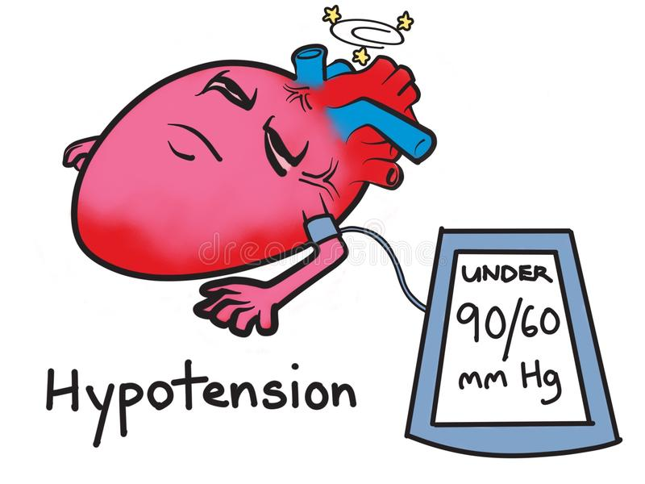
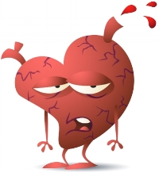
Infection:
Management:
Importance of hand washing, caps, gloves, gown and mask to protect patient.
Hypotension:
Volume expansion in hypovolemic state, look for the source of bleeding.
Low BP with inappropriate bradycardia, then atropine can be given.
Volume overload:
Support the patient with diuretics, morphine and nitrates if pulmonary edema present.

Slide 42
PATIENT EDUCATION ABOUT SELF CARE
In general, people who have angioplasty can walk around within 6 hours after the procedure. Complete recovery takes a week or less. Keep the area where the catheter was inserted dry for 24 to 48 hours. If the catheter was inserted into patient arm, recovery is often faster.

Slide 43
If the doctor put the catheter in through patient groin:
Walking short distances on a flat surface is OK. Limit going up and downstairs to around twice a day for the first 2 to 3 days.
DO NOT do hard work, drive, squat lift heavy objects, or play sports for at least 2 days, or until health care provider tells, it is OK.
If the doctor put the catheter in patient arm:
DO NOT lift anything heavier than 10 pounds (4.5 kilograms). (This is a little more than a gallon of milk).
DO NOT do any heavy pushing, pulling, or twisting.

Slide 44
For a catheter in patient groin or arm:
Avoid sexual activity for 2 to 5 days. Ask the doctor when it will be OK to start again.
Client should be able to return to work in 2 to 3 days if he DO NOT do heavy work.
DO NOT take a bath or swim for the first week. Patient may take showers, but make sure the area where the catheter was inserted does not get wet for the first 24 to 48 hours.
Patient will need to take care of his incision.
Tell the client how often to change the dressing.
If incision bleeds, lie down and put pressure on it for 30 minutes.
Take the medicines exactly as health care provider tells. DO NOT stop taking them without talking to heath care provider.
Patient should eat a heart-healthy diet, exercise, and follow a healthy lifestyle. Health care provider can refer the client to other health experts who can help client learn about exercise and healthy foods that will fit into his lifestyle.

Slide 45
CONCLUSION
The rising number of cardiac catheterizations performed and advances in pharmaceuticals and technology mean that nurses need to be ever more vigilant in assessing for vascular complications in post cardiac catheterization patients. Nurses can help to develop protocols and policies to ensure a consistent approach to the care of patients undergoing cardiac catheterization in their facility.

